Slide 1
Introduction to Software Business Product management
Week 1 Day 2
Led by: Emily Crose
for
Oakland University

Slide 2

Day 1 recap

Slide 3

Question or clarifications?

Slide 4

Modern software development concepts
Notes:
Today, we’re going to talk at a high level about how modern software is imagined, developed and delivered. We will get into more specifics on this process when we examine the Software Development Life Cycle, but for now, let’s try to visualize exactly how software construction works.

Slide 5

Imagine an outstanding app
Notes:
Everyone nowadays has a smart phone (hardware) and these smart phones have an astounding amount of sensors and wizzbang features on them that apps can use. But as I’m sure we’ve all noticed, not every app is actually all that great. So what I want us all to do for a minute is think about the best app you’ve ever used. Let’s talk about some things that made this app so great to you.

Slide 6
Why would we make an app?
Notes:
You may be wondering why we would want to use software at all to solve any of our problems. The modern world has turned to software largely because of how versatile it is at solving modern problems. It’s not just about entertainment, it’s about letting techno

Slide 7

How do we build a quality app?

Slide 8

What is the problem?
What problems does this app solve?
How does it solve these problems?

Slide 9

syntheszing a solution
Notes:
We will need to synthesize the solutions we’ve come up with into an app.

Slide 10
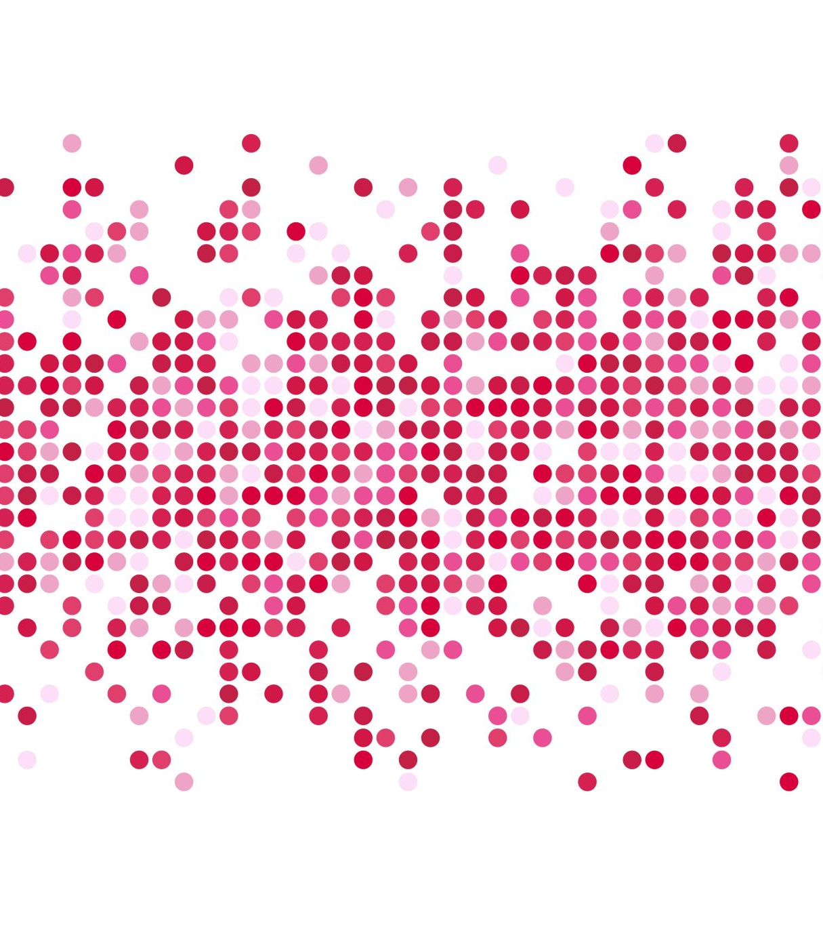
Generating requirements

Slide 11

“Pseudo”code
Notes:
The exercise of producing “pseudocode” can help solidify concepts into achievable actions which can be programmed and build as an application.

Slide 12

Process flowchart
Notes:
We can also use flowcharts as a tool to outline the way that information is generated and processed by a system. Using tools like pseudocode and flowcharts can help build an idea of exactly how the program will do what it’s supposed to do.

Slide 13

Separation of duties
Notes:
Separation of duties are important for defining exactly how and where processing happens. We will talk more about this topic when we get deeper into technical explanations, but for now, we should be aware that the specifics of how we process information is important.

Slide 14
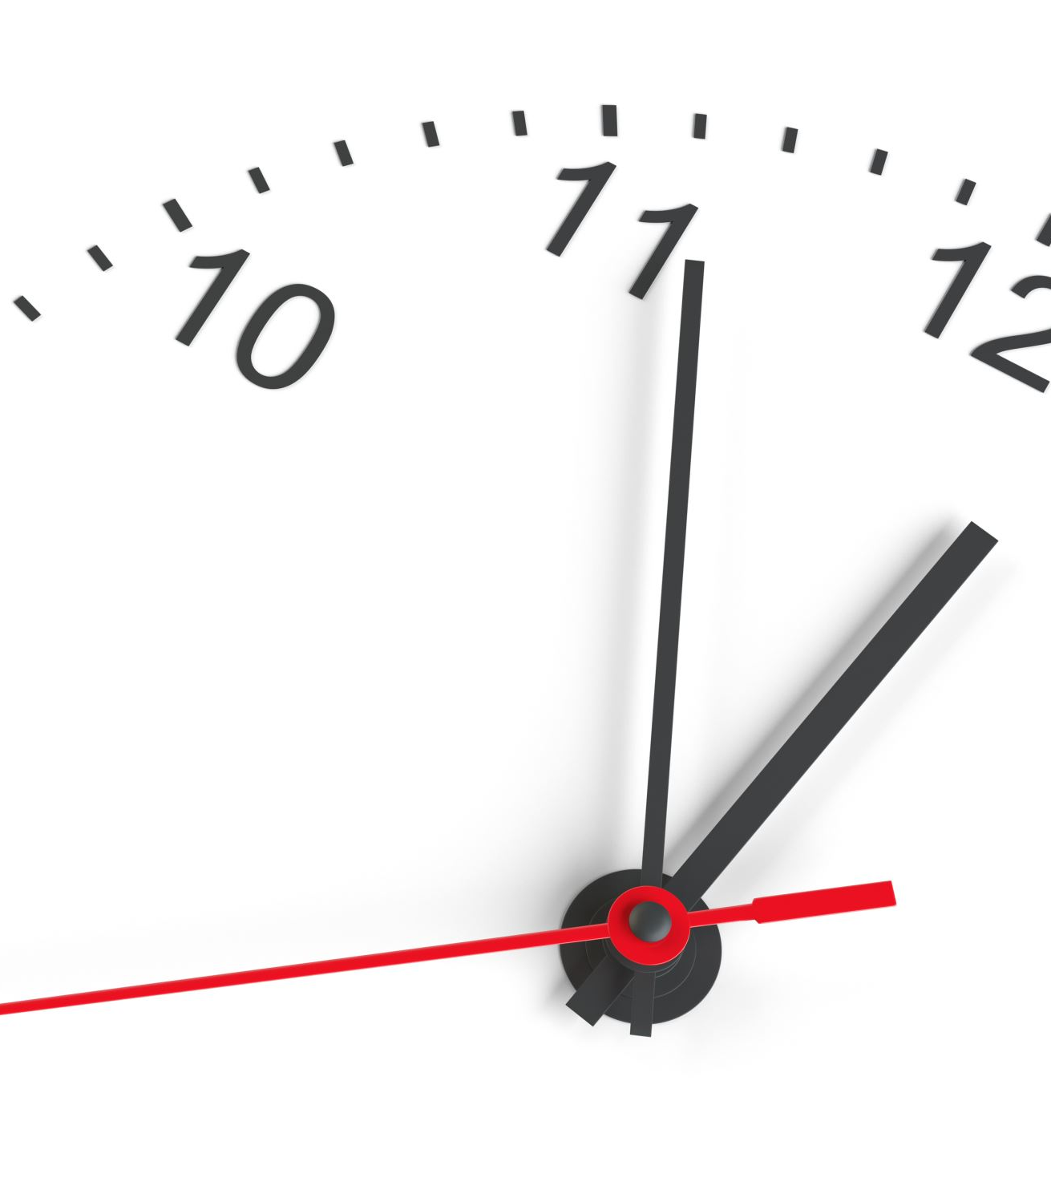
10 minute break

Slide 15

Testing
Does the code work as expected?
Does the code solve the problem we identified?
What does the code work on?
Does the code function with all of our supported systems?
Do we even know what possible systems exist in the field?
Notes:
When we do our testing, we need to ask a few questions about the app’s functionality.

Slide 16

Code distribution

Slide 17

Problem discovery
Notes:
What happens if we discover a problem after we ship the code? What are our options?

Slide 18
Who are our users?
Do we know who they are?
What kind of sensitive information might we be processing?
Personally identifiable information?
HIPAA information?
Legally sensitive?
Notes:
Who are our users? What do they care about? Is there any sensitive information we may be processing that we need to take into account?
Is there a chance that we will run into unforeseen legal governance that will complicate either the way that we process information or store that information.

Slide 19
Supporting those customers
How do our customers contact us?
How do we contact them?
Do we have field support?
What is our process for addressing customer concerns/complains?
What is our process for addressing customer feature requests?
Ticketing system?

Slide 20

Questions?

Slide 21

Review Day 2

Slide 22

Preview day 3

